Slide 1
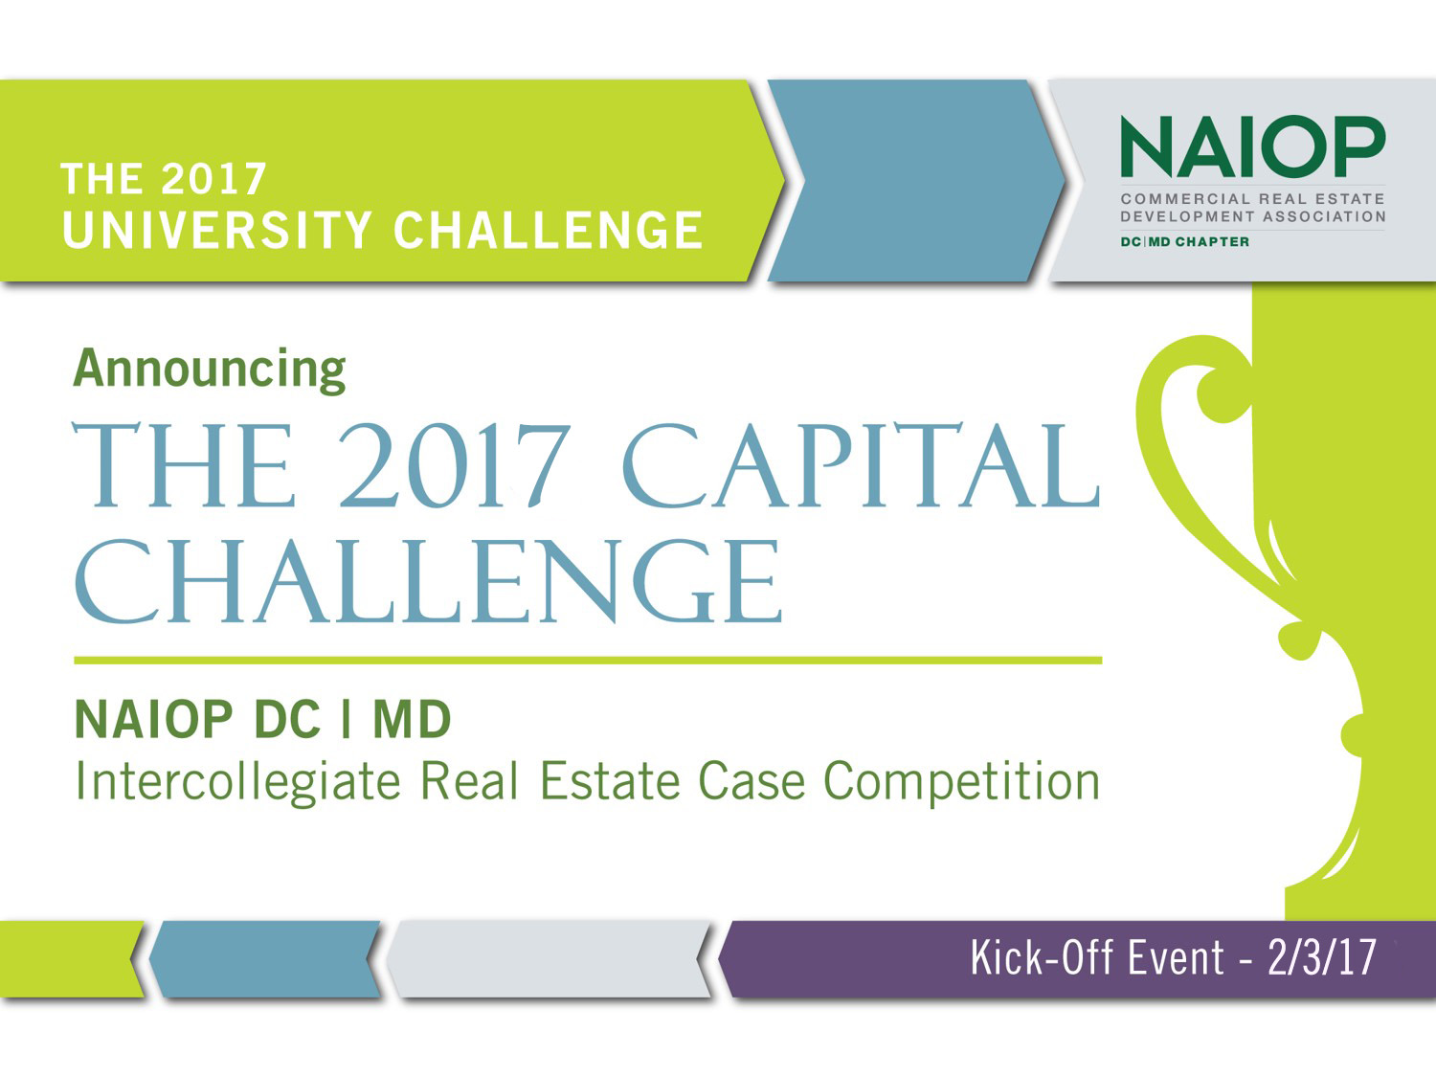

Slide 2
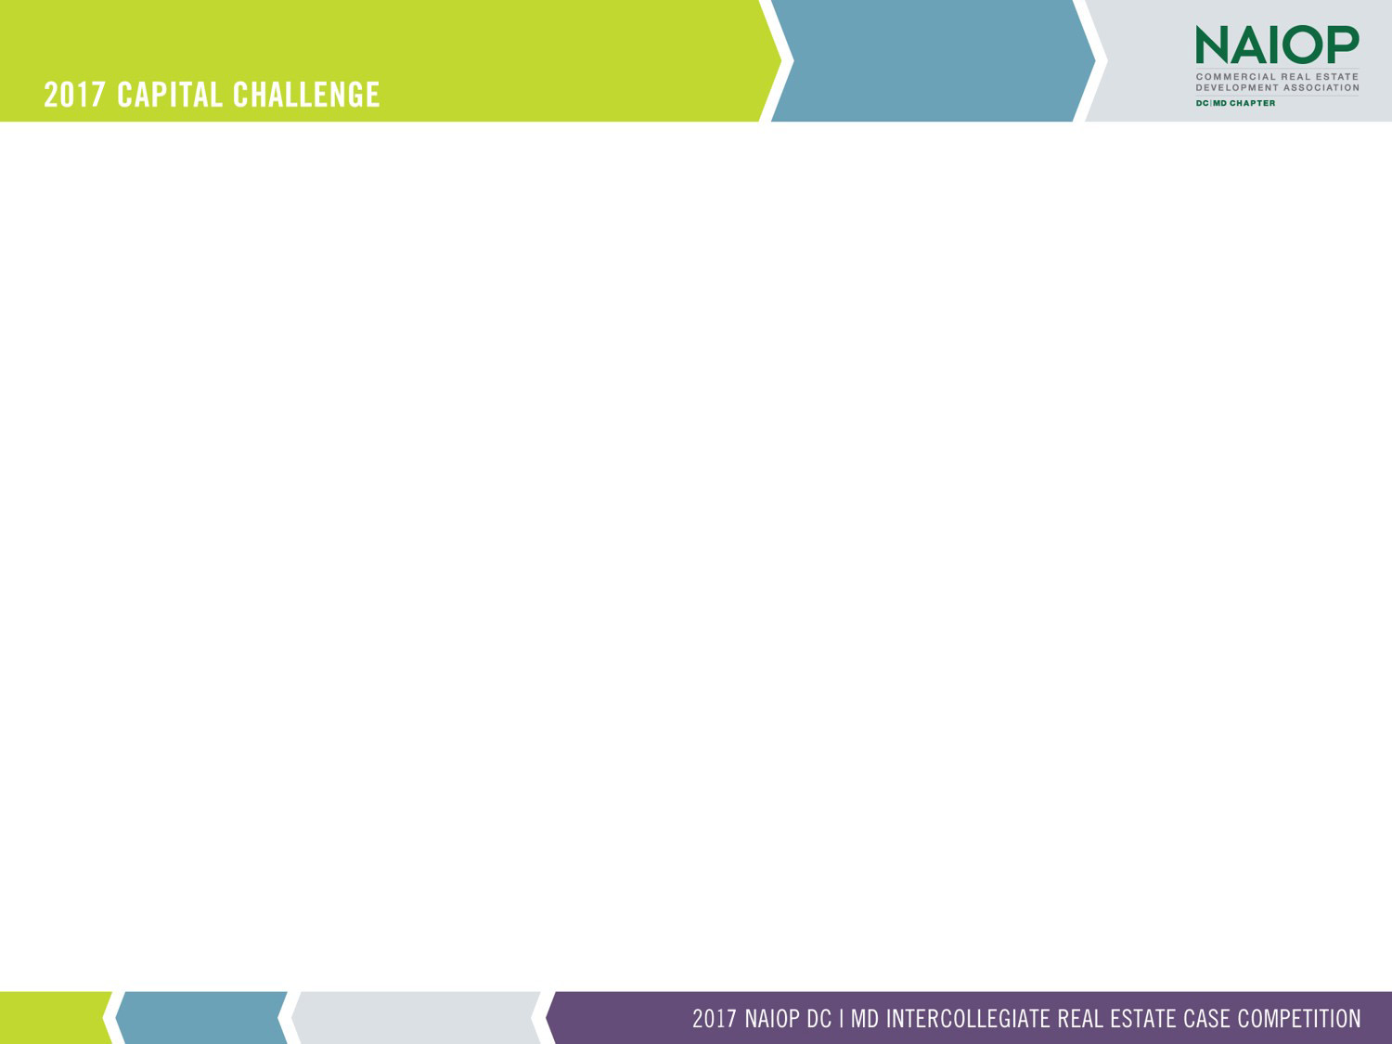
AGENDA
Welcome Participants
Consultant Sponsors
Challenge Calendar
Case Presentation
Team Assignments
Questions?

Slide 3




WELCOME PARTICIPANTS

Slide 4
CONSULTANT SPONSORS
Architecture:
Cooper Carry
HKS Architects
KGD Architecture
SmithGroupJJR
WDG
Brokerage:
Avison Young
Brandywine Realty Trust
CBRE
EDGE Commercial Real Estate
Transwestern
Developer:
Chesapeake Real Estate Group
Grosvenor
Penzance
The JBG Companies
Trammell Crow Company
Construction:
Clark Construction Group
Coakley & Williams Construction
Donohoe Construction
HITT Construction
Whiting-Turner Contracting
Finance:
EagleBank
First Virginia Community Bank
PNC Real Estate
Metropolis Capital Advisors
US Bank
Civil Engineers:
Bohler Engineering
Dewberry
Langan Engineering
Rodgers Consulting
VIKA

Slide 5
SCHEDULE
  February 3rd - Capital Challenge Kickoff
  Case presentation
  Challenge Reference Guide
  Consultants assigned
  Challenge judging and final presentation schedule announced
  March 10th - Capital Challenge written and digital report due to NAIOP
  Report requirements in Challenge Reference Guide
  March 24th - Oral Judging Presentations -
  Judging to held beginning at 8:30 am Clark Construction 16th floor
  Order of Presentations: Georgetown, American University, University of Maryland
  Johns Hopkins, George Mason
  April 5th - Capital Challenge Summary Presentations and
  Award Celebration
  Location TBD beginning 6:00pm
  Order of Presentations: George Mason, Johns Hopkins, University of Maryland,
  American University, Georgetown

Slide 6

CASE DISCUSSION
Richard Greenberg, Principal

Slide 7

CASE DISCUSSION
COMSAT Campus
February 3, 2017
Presenters
  Bob Elliott, Lantian Development
  Brian McLaughlin, Lantian Development

Slide 8

PRESENTATION OVERVIEW
Lantian Development
Comsat
  History
  Property
Case Challenge
  Getting to What is Most Helpful
Question and Answer
Site Visit / Property Tour

Slide 9
LANTIAN DEVELOPMENT
Founded 2014, based in Bethesda, MD
Privately held, foreign capital
  Long term investment horizon
  Value add, repositioning and opportunistic
  Investing in the DMV
  Multiple asset classes and land
6 closed investments, more than $1.5B evaluated
  400 acres; over 1M sf of institutional and office space
  $60+ million in equity
  Locations
    Montgomery / Prince George’s County (MD)
    Alexandria (VA)

Slide 10
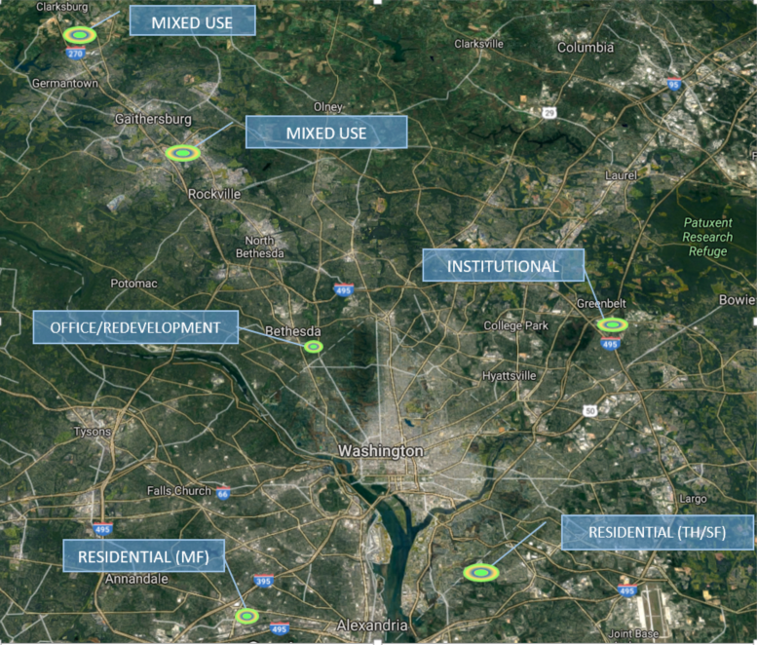

Lantian Development
Investment Snapshot (Jan 2017)

Slide 11
Brief History of COMSAT
COMSAT (Communications Satellite Corporation)
  Communications Satellite Act of 1962
  Public, federally funded corporation intended to develop a commercial and international satellite communication systems; incorporated as a publicly traded company in 1963
    In August 1964, COMSAT helped create and was majority owner in the International Telecommunications Satellite Consortium (INTELSAT)
  Was instrumental in the expansion of communications throughout the world
COMSAT Laboratories
  To further satellite technology, in September 1969, COMSAT opened COMSAT Laboratories, a research and development arm, in Clarksburg, Maryland
Lockheed Martin
  On 20 September 1998, Lockheed Martin Corp. and COMSAT Corp jointly announced a two-phase merger valued at approximately $2.7 billion
  COMSAT became part of Lockheed Martin Global Telecommunications
  In Mid-2000’s, Lockheed Martin began to dismantle portions of the COMSAT Laboratories property

Slide 12
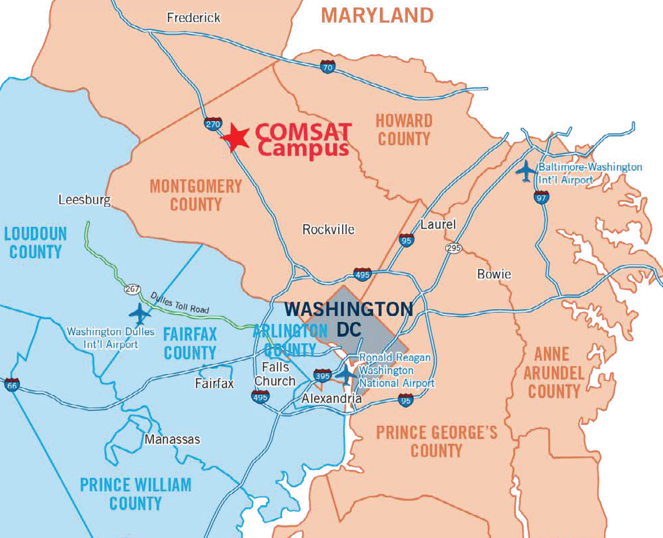
Where is COMSAT Laboratories?

Slide 13
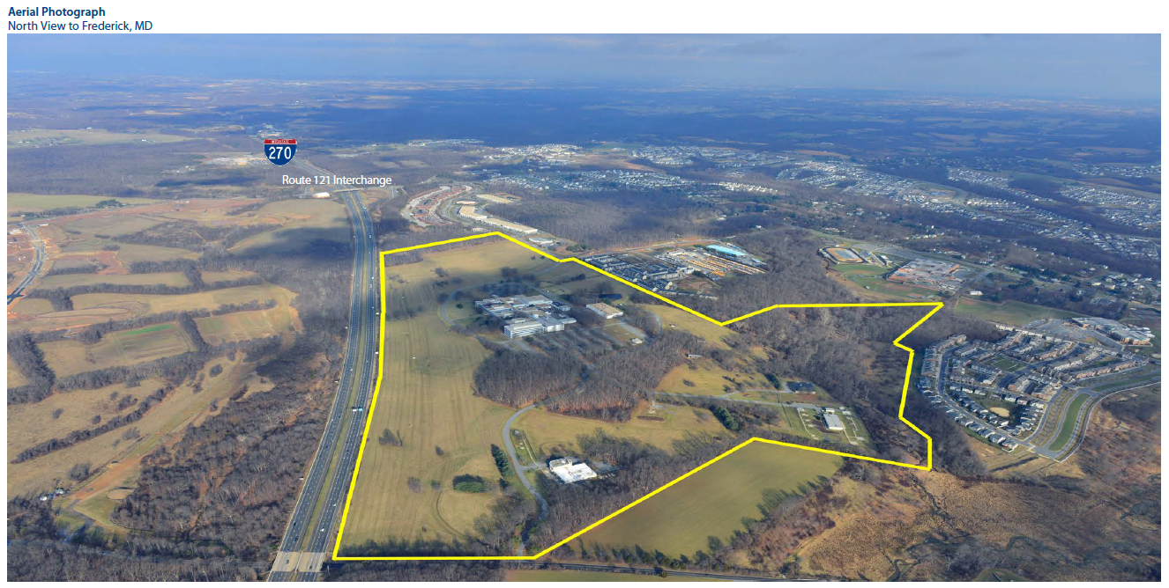
COMSAT – Looking North
Approximately 204 acres
Improved with a 613,000 square-foot of office and lab buildings

Slide 14
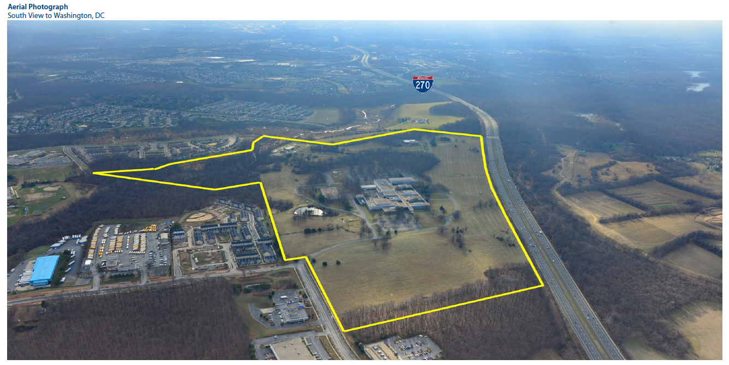
COMSAT – Looking South
Main building (550,000sf) was last occupied by Lockheed Martin in 2007
Intelsat occupied a warehouse until September 2013
14

Slide 15
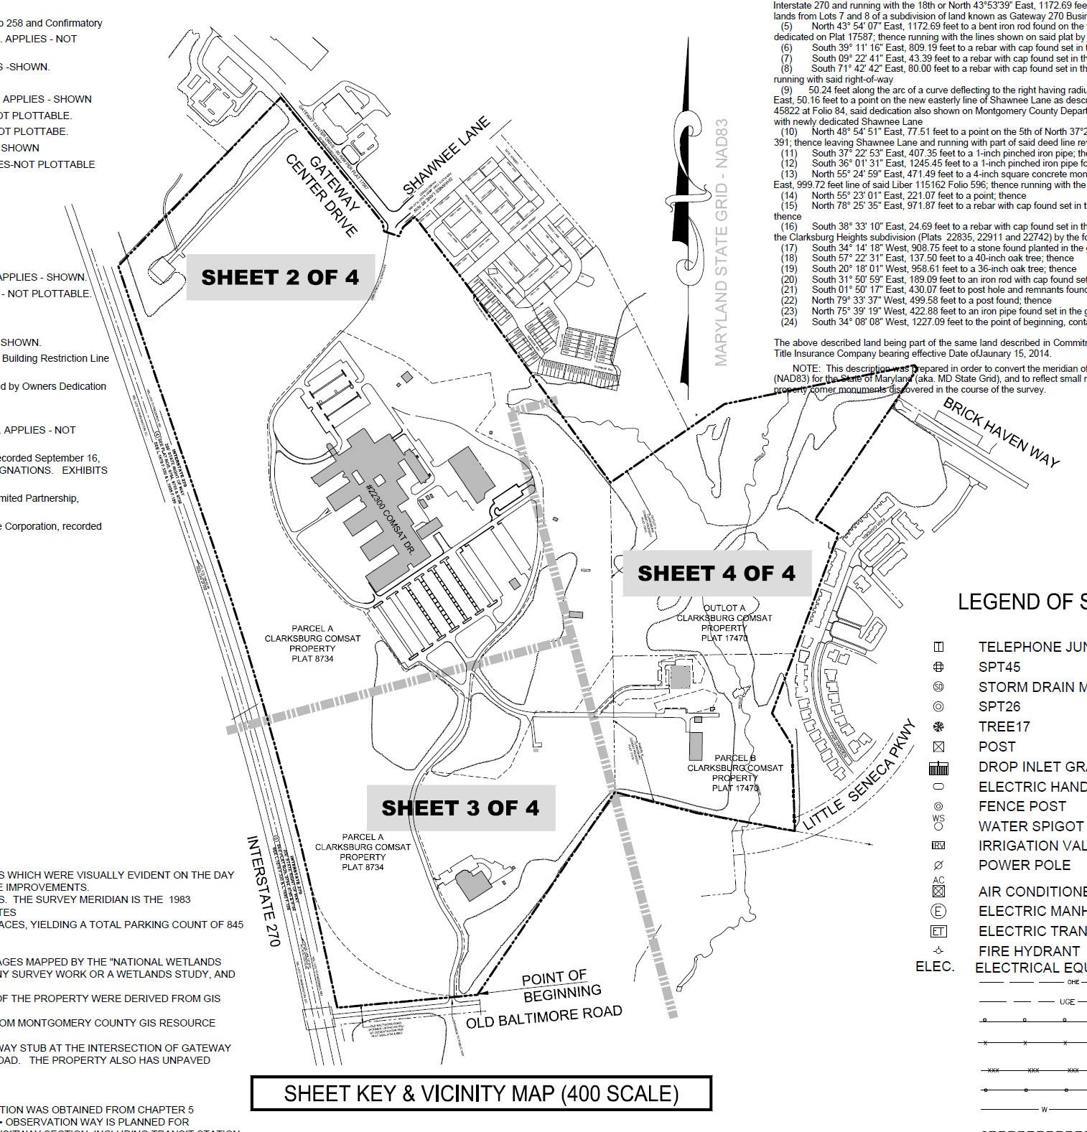
Survey (and Aerial View)

Slide 16
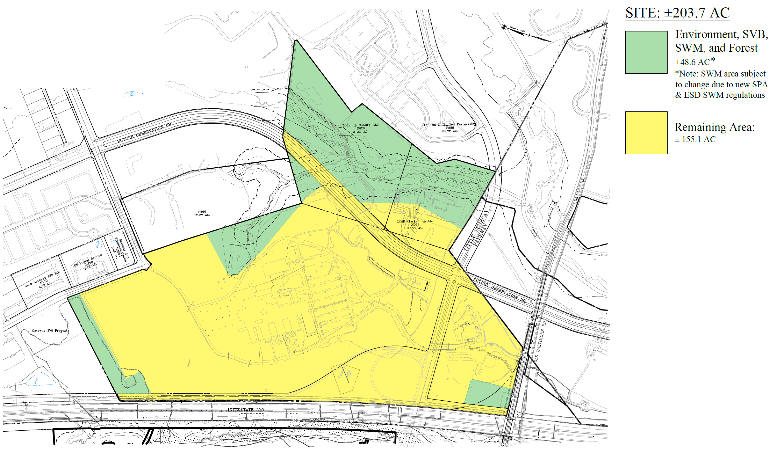
Property – SWM and Forest

Slide 17
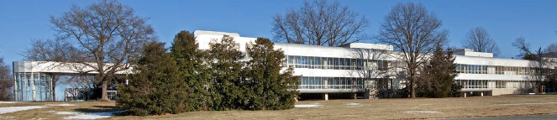
Main Building
Approximately 555,449 square foot, two to four-story office/R&D building
Offices as well as special use facilities including laboratories, computer rooms, light assembly, a 300-seat cafeteria and a 117-seat auditorium
Building is divided into self-contained wings connected via a central corridor
Constructed in phases between 1969 and 1986
Over the past 2 decades, members of the historic preservation community have made a push to highlight some of the earliest elements of the building’s design
  In particular, attention has been focused on the westernmost façade comprised of a two-story glass “catwalk”, the most visible component from I-270. Connected to the catwalk are 4 office that extend westward from the building’s main north/south spine and are separated by small exterior courtyard
  The building has been considered for designation but has failed to achieve that status

Slide 18
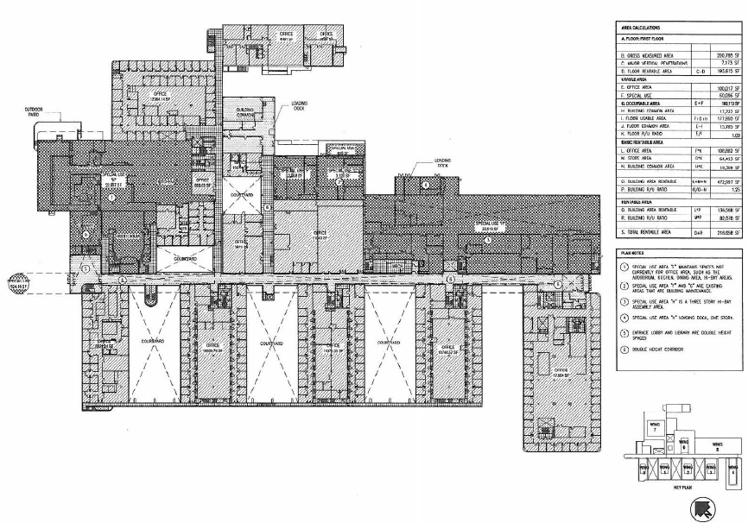
1st Floor Plan

Slide 19
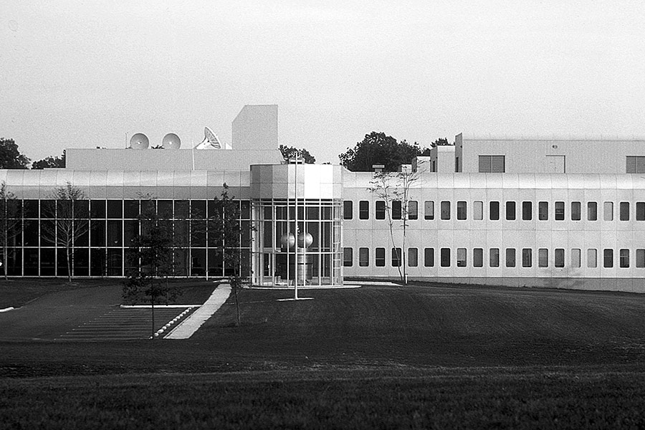
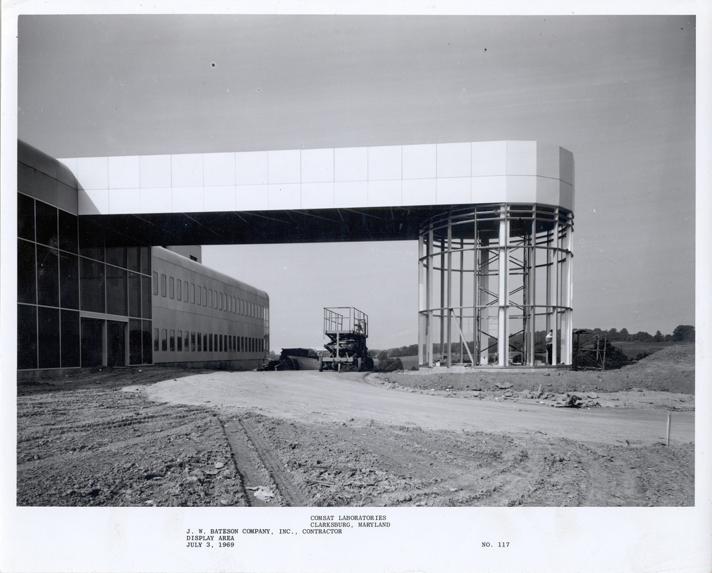
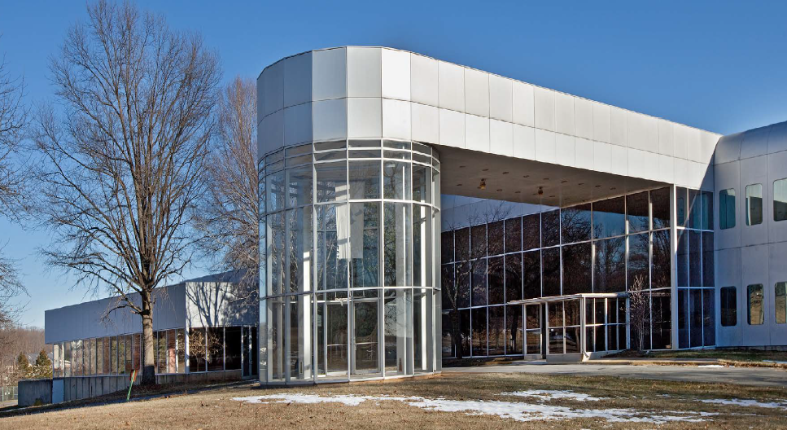
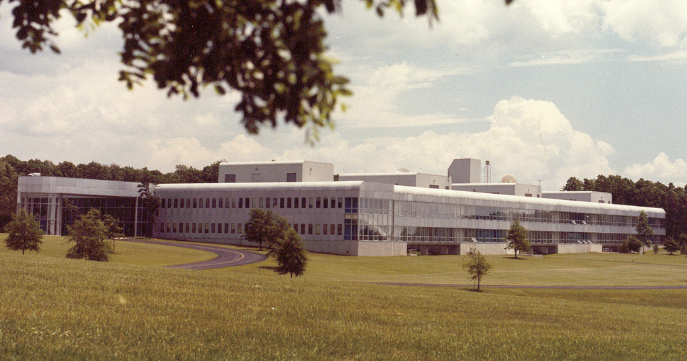
Main Building

Slide 20
Location
Heart of the I-270 Corridor with 3,600 feet of I-270 frontage
Planned four-way interchange East side of I-270, 25 miles from Washington, DC
  Near the Property is the Clarksburg Town Center, a multifaceted development designed to replicate an urban walkable community with residential, retail, and office space.
  Clarksburg Village Center, located at Snowden Farm Parkway and Little Seneca Parkway, offers a variety of retail and food-service amenities to the Clarksburg community.
  West side of I-270, is Cabin Branch, a 535-acre site has been planned for 2.4 million square feet of commercial space, 450,000 square feet of outlet retail, as well as residential housing, a hotel, and several walking paths. This project has already started delivering in 2016.

Slide 21
Access
Access
  Primary access to the Property is via the Route 121 interchange of I-270, a full interchange with Route 121 East (Stringtown Road)
  Accessible from Route 355 (Frederick Road) via Shawnee Lane which proceeds approximately ½ mile due west to the COMSAT Campus.
  County Master Plan recognizes the need to identify additional interchange capacity along I-270. The Master Plan recommends a new interchange with I-270 at the extension of Little Seneca Parkway. This interchange, which would serve the southern portion of Clarksburg, is proposed to be located in the southwest portion of the COMSAT property, approximately 800 feet north of West Old Baltimore Road.
  Corridor Cities Transitways (CCT) will terminate at the COMSAT Campus, providing bus rapid transit along the I-270 Corridor between the Property and the Shady Grove Metrorail station.
For the purposes of this case, please assume these features are required, but that their specific locations may be reasonably adjusted in order to achieve the vision of a new masterplan.

Slide 22
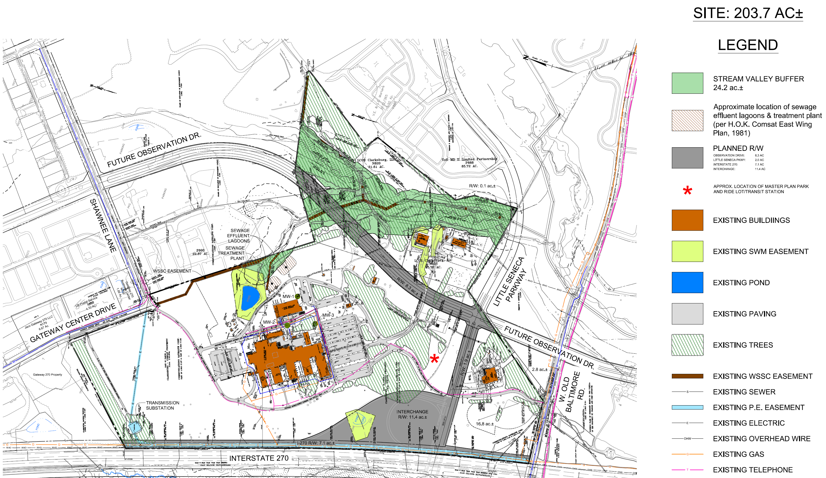
Site – Consolidated Diagram

Slide 23
Aerial and Diagram Comparison

Slide 24
Zoning
Montgomery County Council adopted a countywide zoning change
  Eliminated I-3 Zone replaced it with EOF Zone (Employment Office, specifically EOF-0.75)
  Permitted uses in the EOF-0.75 Zone are similar to the I-3 Zone, with the exception that it will allow up to 30% of the eligible FAR to be designated for residential development
  Zoning attorneys consulted by the Owner have advised that it would have an excellent chance of being rezoned to the CRT Zone
  CRT Zone, under the new ordinance, would allow for more density overall, more retail density, and potentially more residential density

Slide 25
Zoning (cont.)
Specific zoning requirements under the EOF designation, including height limitations and residential lot densities, are as follows:
  Height limitation: 100 feet
  Maximum density: commercial floor area: 4,000,000 sf (manufacturing, industrial, retail, office; 40% life sciences condition to achieve max)
  Maximum density: residential dwelling units: 1,200 – 1,400 (30% of total development gross floor area)
  Maximum density: total gross floor area: 5,714,000
CRT may offer flexibility on total amount of varying product types
  Evaluate why you may want a change in Zoning designtion

Slide 26
THE CASE ASSIGNMENT
Create a masterplan and strategy to redevelop the entire property
  Diagram of proposed uses; timing and phasing of the whole development
  May include none, some or all of the Main Building or auxiliary buildings
    If portions of the buildings are to be retained, a clear diagram of what is to be retained, along with an explanation of the expected costs, use trade-offs, and other relevant factors must be provided
Specific recommendation for your proposed first phase of development that will be a catalyst for the property’s redevelopment
  Conceptual design using existing representative regional development examples
  Create a name for the full project and the first phase

Slide 27
THE CASE ASSIGNMENT (continued)
Market research and basic supply and demand drivers for all proposed uses
  Exhaustive detail of supply/demand is not necessary
  General trends, growth opportunities, market risks and analysis related to the proposed uses
Financial analysis, pro formas, development costs and investment returns
  Summary proforma for the total development, by use, cost and expected returns
  Detailed proforma for the first phase of development
  Returns should be provided using 2 metrics – ROC and IRR
The primary focus is the overall master plan and the proposed first phase of development as well as your evaluation and financial analysis of the costs and returns.

Slide 28
SITE VISIT | HOW TO GET THERE
Property Address
  22300 Comsat Drive, Clarksburg, MD 20871
If using GPS, use this address:
  22505 Gateway Center Drive, Clarksburg, MD
    Exit 18 off I-270 (Route 121 – Stringtown Road)
    Clarksburg Post Office near the Main Entrance
  Drive past the Post Office to the end of Gateway Center Drive to Shawnee Lane
    Enter the property through the yellow gate
Watch out and be careful!
  Property tenant actively testing equipment
  Meet at the Main Entrance (North side of the building)

Slide 29
Question and Answer

Slide 30
EXPECTATIONS
Meet with your consultant sponsors! They are your expert team
Be courteous of time constraints, don’t wait until the last minute!
All questions after today, asked and answered on the blog
Impress the judges, they will ask the tough questions
Have fun!

Slide 31
TEAM CONSULTANT SPONSORS
Team Assignments!

Slide 32
TEAM CONSULTANT SPONSORS
American
Grosvenor
Brandywine Realty Trust
Coakley & Williams Construction
WDG
VIKA Inc.
EagleBank

Slide 33
TEAM CONSULTANT SPONSORS
George Mason
Trammell Crow Company
CBRE
Balfour Beatty Construction
HKS Architects
Langan Engineering
First Virginia Community Bank

Slide 34
TEAM CONSULTANT SPONSORS
Georgetown
The JBG Companies
EDGE Commercial Real Estate
Clark Construction Group
Cooper Carry
Bohler Engineering
Metropolis Capital Advisors

Slide 35
TEAM CONSULTANT SPONSORS
Johns Hopkins
Chesapeake Real Estate Group
Transwestern
Donohoe Construction
KGD Architecture
Rodgers Consulting
PNC Real Estate

Slide 36
TEAM CONSULTANT SPONSORS
University of Maryland
Penzance
Avison Young
Whiting-Turner Contracting
SmithGroupJJR
Dewberry
US Bank

Slide 37
Good Luck!

